Slide 1
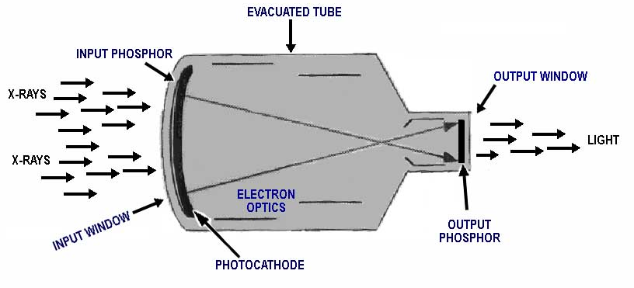
Maintain an image intensifier-based X-ray system
Image intensifier
Fluoroscopy fundamentals
  principles of operation / function / use / scientific principles
Construction
  components / system diagram inputs/ outputs
18.6.5 Maintain an image intensifier
Unit C18.6 Maintaining Medical Imaging Equipment
Module 279 19 C Medical Instrumentation II
©
dr. Chris R. Mol, BME, NORTEC, 2016

Slide 2
Fluoroscopy X-ray systems
Radiography (X-ray) equipment, produces static, film images. Fluoroscopy (X-ray) equipment, produces dynamic images.
The X-ray tube, HV generator and Collimator are very similar between radiography and fluoroscopy imaging.
The main difference is in the X-ray detector.
Whereas Radiography images are captured by X-ray film, Fluoroscopy images are captured by an Image Intensifier, combined with a TV system.
A related difference is in the mechanical construction of the tube and detector and the patient positioning. Because fluoroscopy has different clinical applications, it requires different mechanical constructions.
©
Fluoroscopy System
dr. Chris R. Mol, BME, NORTEC, 2016

Slide 3
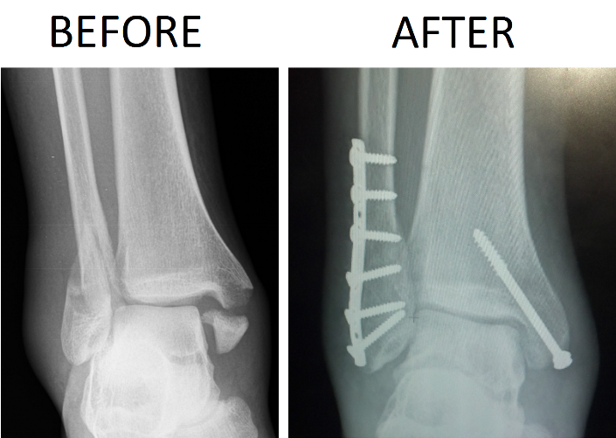
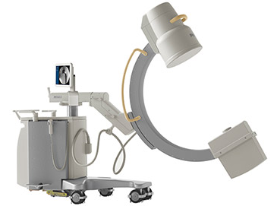
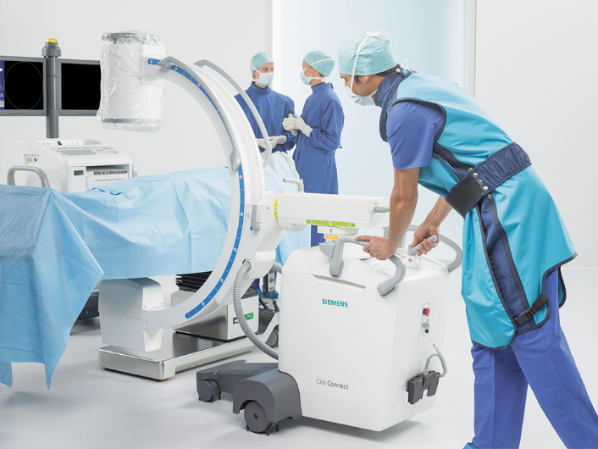
Surgery C-arm
Mobile Surgical C-arm, for use in the operating room, especially for orthopedics (bones). When a C-arm is rotated to a different projection, the object in the center remains visible.
Surgical C-arms are often positioned in the corner of the Operating Theatre and only wheeled towards the surgery table for e.g. checking the correct positioning of metal constructions.
Image Display
Image Intensifier
System Control
tube & collimator
X-ray
Generator
Surgical C-arm
©
Fluoroscopy System
dr. Chris R. Mol, BME, NORTEC, 2016

Slide 4

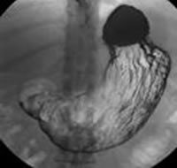
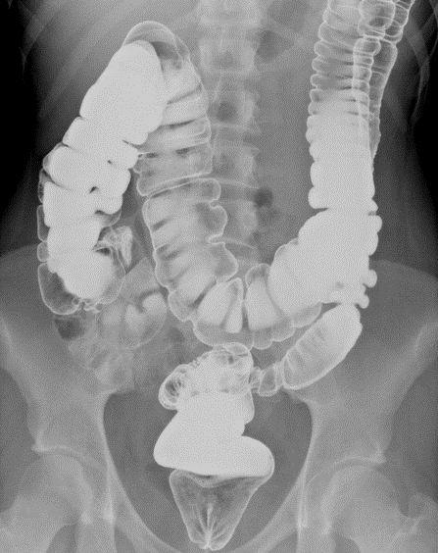
Universal RF system
Universal RF system, used to image dynamic body processes.
Depending on the procedure, a dye or contrast substance may be injected intravenously into the patient in order to better visualize the organs being studied.
2x X-ray cassette positions
Image Intensifier
2x tube & collimator
Combined Radiography / Fluoroscopy system
Stomach
Intestines
©
Fluoroscopy System
dr. Chris R. Mol, BME, NORTEC, 2016

Slide 5
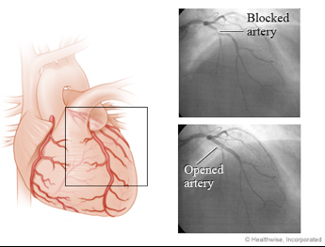
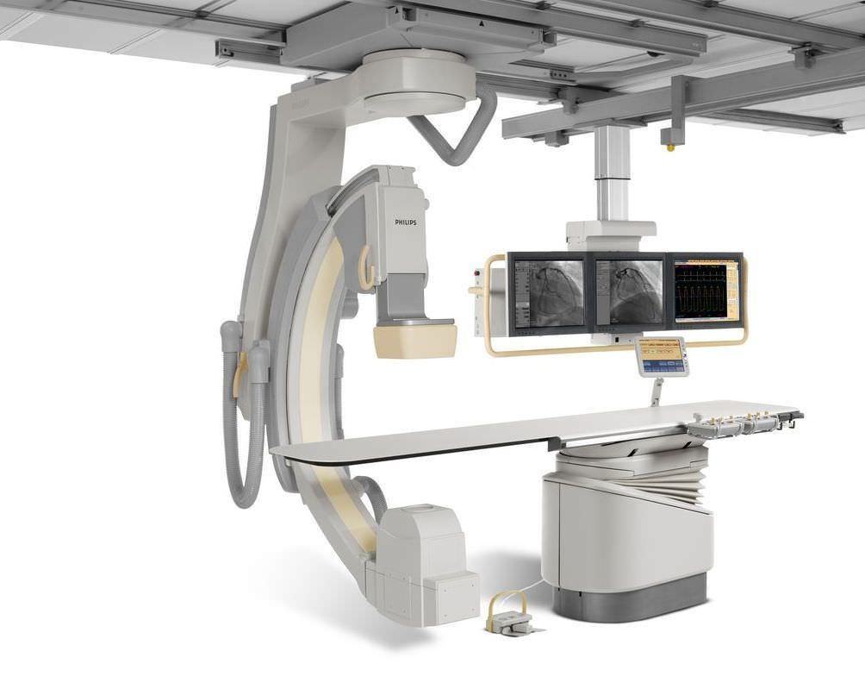
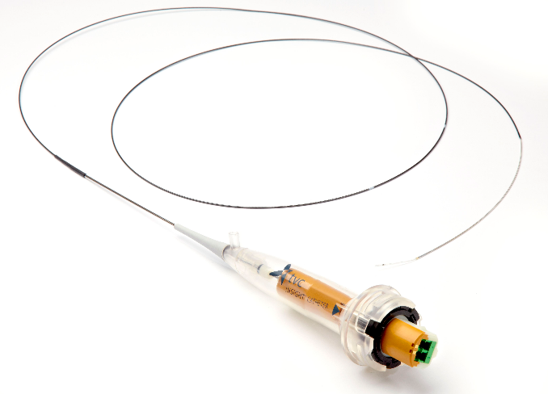
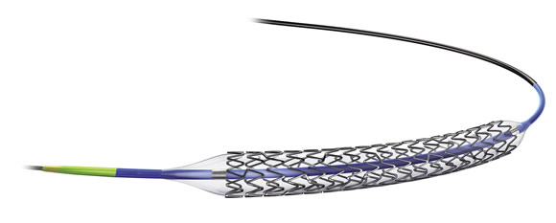
Cardio / Angiography system
Interventional X-ray system, for interventional procedures in coronary and other blood vessels.
A catheter is introduced into an artery to inject contrast material and to perform e.g. a PTCA (angioplasty) procedure.
Flat Detector
Display
catheter
X-ray tube & collimator
balloon and stent for PTCA procedure
Interventional Cardiology system
X-ray images
©
Fluoroscopy System
dr. Chris R. Mol, BME, NORTEC, 2016

Slide 6
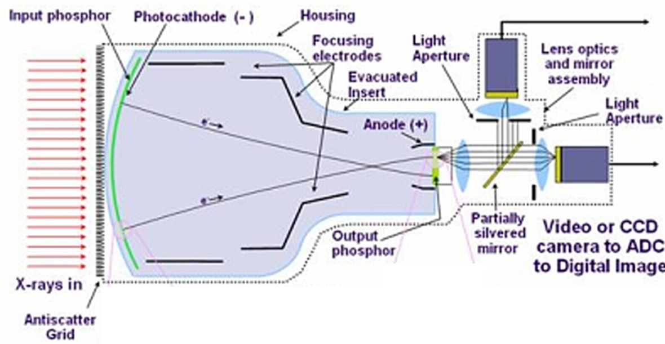
Image Intensifier – TV system
An image intensifier includes:
input phosphor converts the incoming X-rays into electrons.
the electrons are accelerated with 25 kV and hit the output phosphor screen.
this output screen converts the electrons into light photons
A CCD camera converts this light into digital electrical signals, which can be displayed as an image.
a side channel captures light to manage the automatic exposure control.
An anti-scatter grid is placed in front of the image intensifier to absorb the incoming X-ray photons that do not come straight from the X-ray tube (scatter-radiation).
©
Fluoroscopy System
dr. Chris R. Mol, BME, NORTEC, 2016

Slide 7
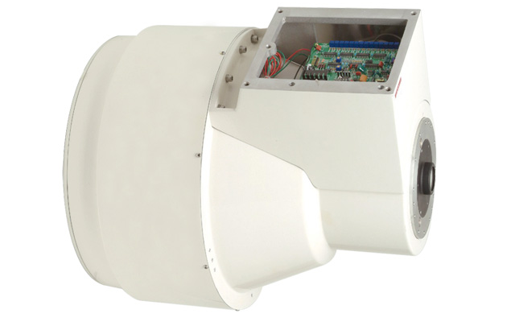
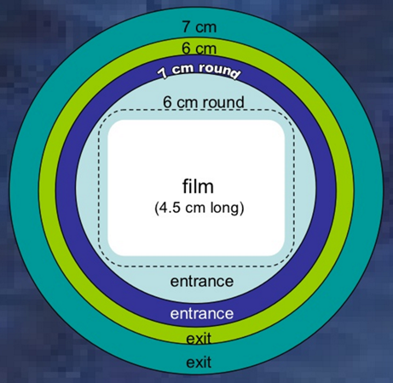
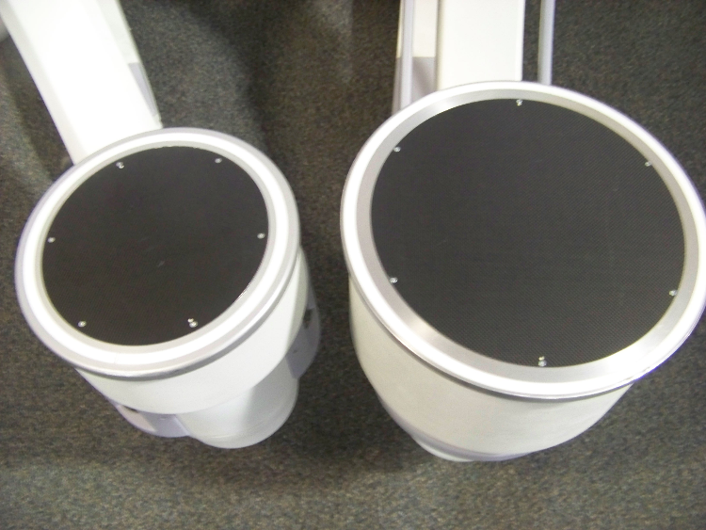
Image Intensifiers
Collimator setting needs to be adapted to the size and position of the image detector: no X-ray radiation should be sent out to where it is not detected. Fluoroscopy systems have preset collimator settings to prohibit transmitting X-ray outside the ‘field of view’.
Image intensifiers come in different sizes, but always have a round shape. This is an easy way to distinguish the resulting images from rectangular Flat Detector images (next).
©
Fluoroscopy System
dr. Chris R. Mol, BME, NORTEC, 2016

Slide 8
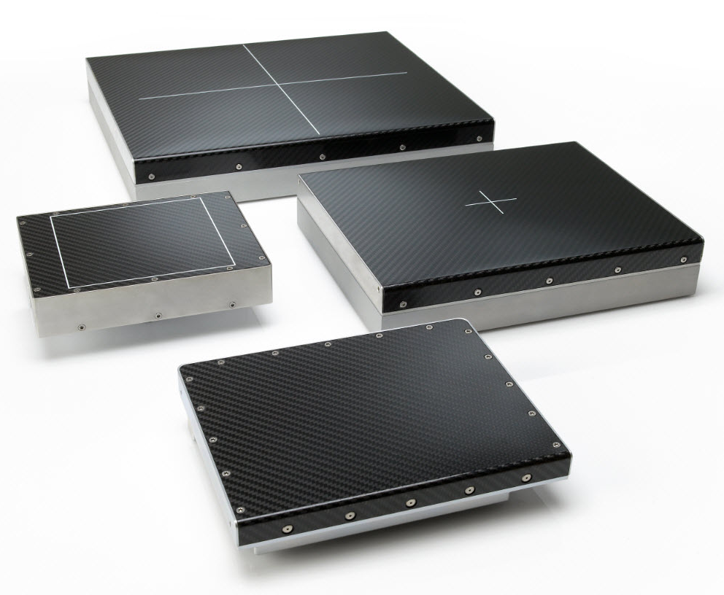
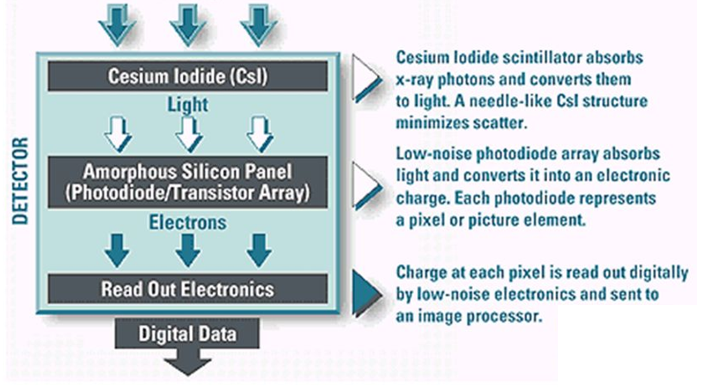
Dynamic Flat X-ray Detectors
X-ray
Over the last 20 years, the medical technology industry has developed flat detector technology that is capable to capture 25 images per second. Although with a higher price tag, these systems are rapidly replacing Image Intensifier based systems.
Dynamic Flat X-ray Detectors use the same sort of technology as consumer LCD TV’s. The price is much higher than a TV because the number of units sold is much lower and factory automation is not as high.
©
Fluoroscopy System
dr. Chris R. Mol, BME, NORTEC, 2016

Slide 9
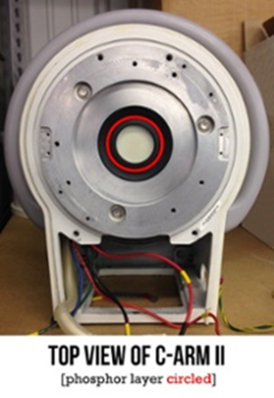
Image Intensifiers require little maintenance
The cleaning of the outer lens and viewing mirror, and the periodic "seasoning" of the intensifier tube, are essential to the system operating at its optimum level.
The manufacturer recommends that the painted metal portions of the intensifier system be wiped with a damp cloth and the lens and viewing mirror cleaned with lens tissue and lens cleaning solution every thirty days.
"Seasoning" is accomplished by applying an electrical current to the tube for a period of twenty-four hours.
A failing II may begin to show sharp, dark spots in the image. These spots are caused by the breakdown of a coating inside the II's insert. Once you begin to see these, you can expect to see more of them in the near future.
Most IIs have years of useful life in them, but every II will need replacement at some point.
©
Fluoroscopy System
dr. Chris R. Mol, BME, NORTEC, 2016

Slide 10
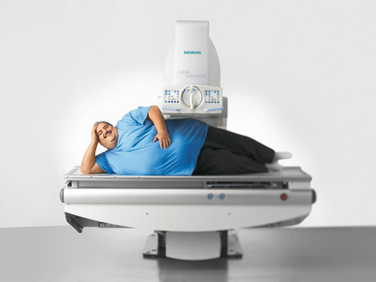
Automatic Exposure Control
Fluoroscopy X-ray systems have Automatic Exposure Control: it is not possible to set generator parameters (kV, mA, pulse duration) manually.
In an Image Intensifier based system, exposure control is usually based on a photo pick-up tube which detects the amount of light coming out of the Image Intensifier. From this, plus the information of what body part is being imaged, an optimal Generator setting is calculated.
It is difficult to get sufficient X-ray radiation through obese patients to get a good quality image.
©
Fluoroscopy System
dr. Chris R. Mol, BME, NORTEC, 2016

Slide 11
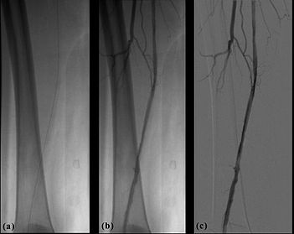
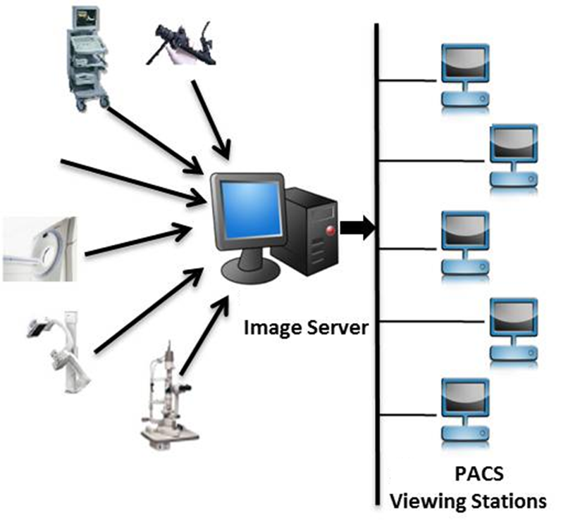
Image Processing and Archiving
Digital images (as opposed to film/optical images) have the advantage that they can be processed. Contrast can be enhanced and noise can be filtered out as much as possible. A very useful image processing technique is the digital subtraction of two images (see picture).
Another advantage of digital imaging is the possibility to store and archive digital images in computers (PACS systems). This also enables other doctors in the hospital to view the images on line and read the associated reports.
Example of digital subtraction of a leg image.
(a) X-ray of leg; (b) X-ray of leg with contrast material in artery; (c) subtraction of image 1 and 2 gives an image of the (contrast in the) artery only, not disturbed by the presence of the bone.
©
Fluoroscopy System
dr. Chris R. Mol, BME, NORTEC, 2016

Slide 12

END
The creation of this presentation was supported by a grant from THET:
see https://www.thet.org/

